Slide 1
Comparative Analysis of Tomato Disease Classification: A Performance Evaluation of CNNs and Traditional Classifiers with Explainable AI
Task 6: Completed Paper
Team : 5
Abu Bakar Hasnath (20301037),
Sabista Ifraj (20301175),
Sameha Kamrul (23266016),
Sania Azhmee Bhuiyan (23266033)
CSE713: Advanced Syntactic Pattern Recognition
Instructor: Annajiat Alim Rasel (AAR)
RA: Md. Humaion Kabir Mehedi
ST: Farah Binta Haque

Slide 2
Outline
Introduction
Objective
Dataset
Data Preprocessing
Methodology
Result analysis
Limitations

Slide 3
Introduction: Defining the problem statement
Importance of tomatoes
Tomatoes hold immense importance globally
extending beyond their culinary appeal
Rich in essential nutrients
Economic value of tomato
paramount importance in global agriculture
serving as a staple crop
significant economic value
How tomato leaf disease causes economic loss
Crop loss
Market value decline
Quality degradation

Slide 4
Objective
Image recognition techniques can be used to identify disease symptoms in tomato plants
Early detection of disease using machine learning can lead to faster response and spreading of disease among neighbouring plants
There is a need to figure out the most efficient machine learning model for tomate disease classification
So that machine learning application can be readily deployed on the agricultural field

Slide 5
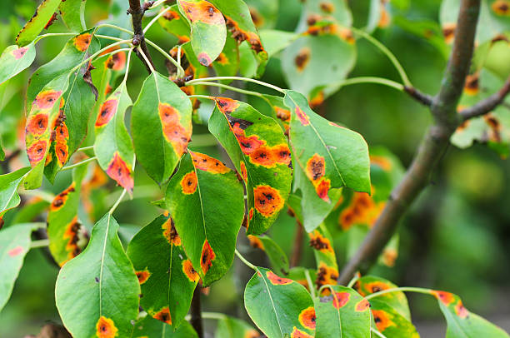
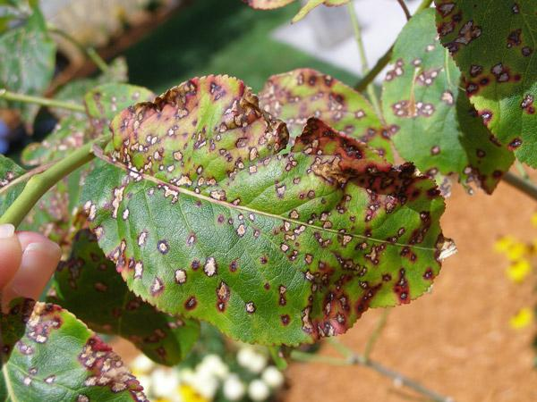
Dataset
Hybrid dataset
Collected from kaggle
Plant village and Tomato Disease
Consists of 20k and 20.6K respectively

Slide 6
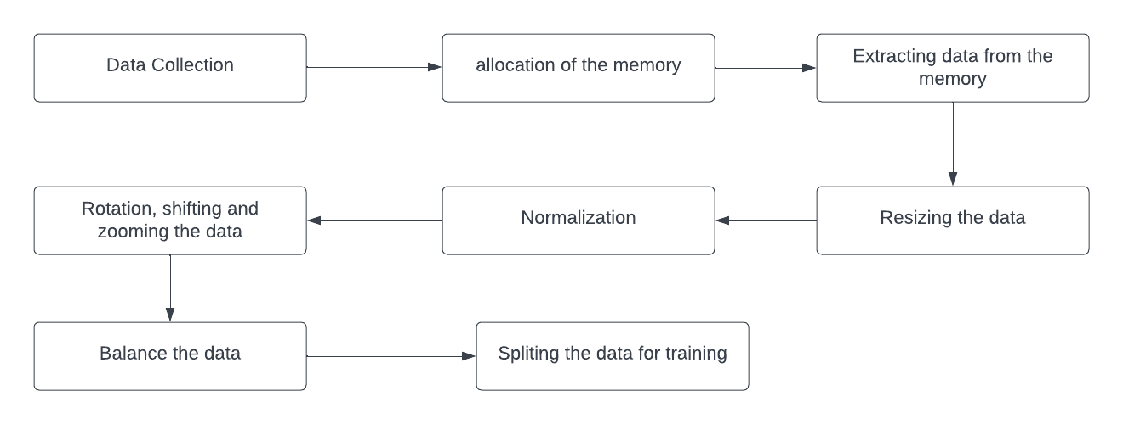
Data Preprocessing
Data preprocessing

Slide 7
Methodology
InceptionResNetV2:
deep convolutional neural network architecture
developed by Google's research architecture team
kernel size (1*1), (3*3), and (5*5)
residual connection intercorporate
Notes:
Healthcare Data Challenge: Healthcare faces challenges in accessing diverse datasets, as medical data is distributed across many institutions globally.
Legal and Regulatory Barriers: Centralized data aggregation for AI training in healthcare is increasingly restricted due to legal and regulatory barriers protecting data privacy.

Slide 8
Methodology
InceptionV3:
Evolved from InceptionResNet V2
capture features at different scales
inception modules are the key component
Auxiliary classifiers are also added to mitigate the layers

Slide 9
Methodology
ResNet50:
deep convolutional neural network architecture
developed by the Microsoft Research team
bottleneck architecture is used
balance of depth and computing efficiency

Slide 10
Methodology
VGG16:
convolutional neural network architecture
developed by Visual Graphic Group (VGG) at University of Oxford
multiple convolutional layers with 3*3 filters
Max pooling layers preserve the most significant features

Slide 11
Methodology
Vision Transformer:
an architecture for image classification
reads the image sequence and processes it using a transformer encoder
Each patch is linearly embedded into a lower-dimensional vector space
final output token is classified by processing it via a classification head

Slide 12
Methodology
Explainable AI:
Contributes in prediction
SHAP (SHapley Additive exPlanations), and LIME (Local Interpretable Model-agnostic Explanation) contributes in input
XAI approaches produce interpretable outputs,
Give insights into the decision making process of AI models

Slide 13
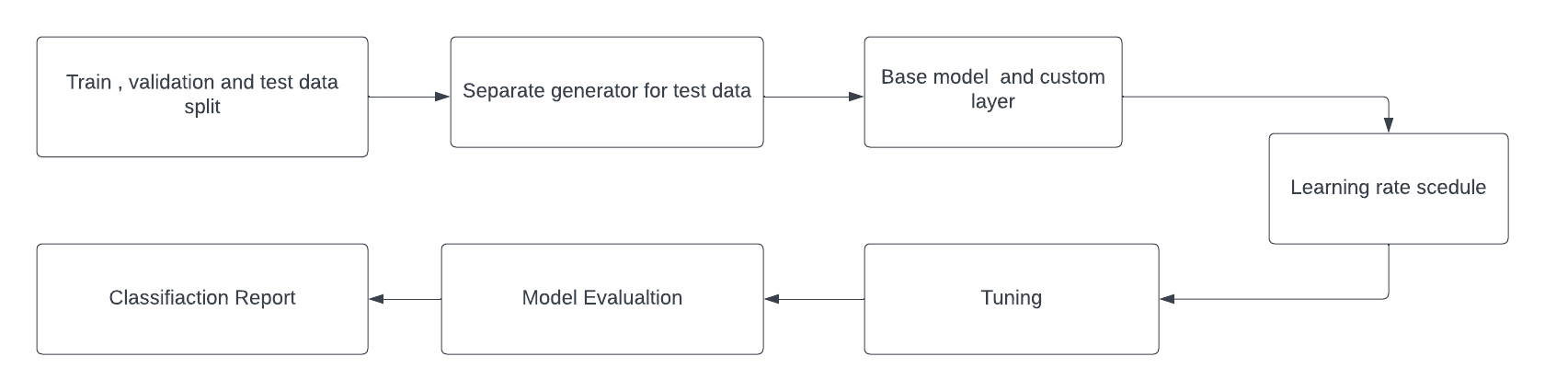
Methodology

Slide 14
Result Analysis
InceptionResNetV2 | 99.17%
InceptionV3 | 95.44%
ResNet50: | 92.97%
VGG16: | 82.76%
Vision Transformer | 30.21%

Slide 15
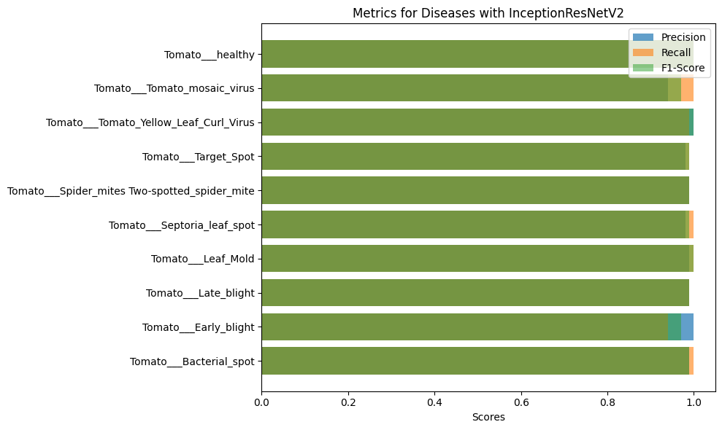
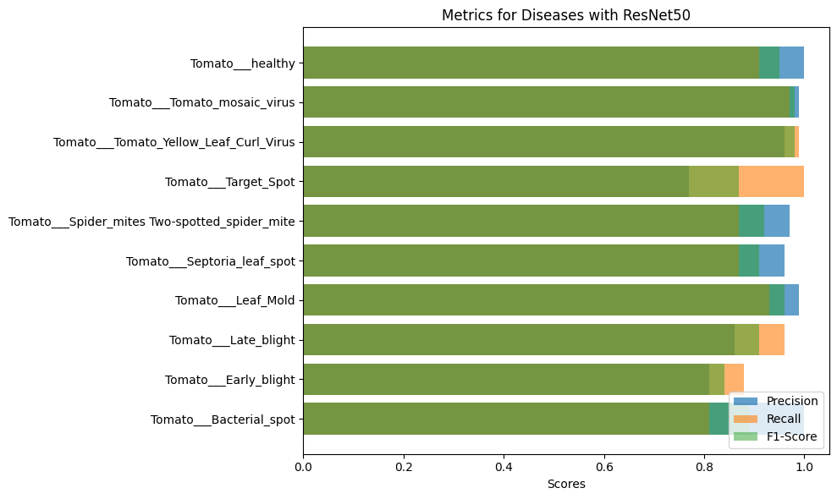
Result Analysis
InceptionResNetV2
ResNet50

Slide 16
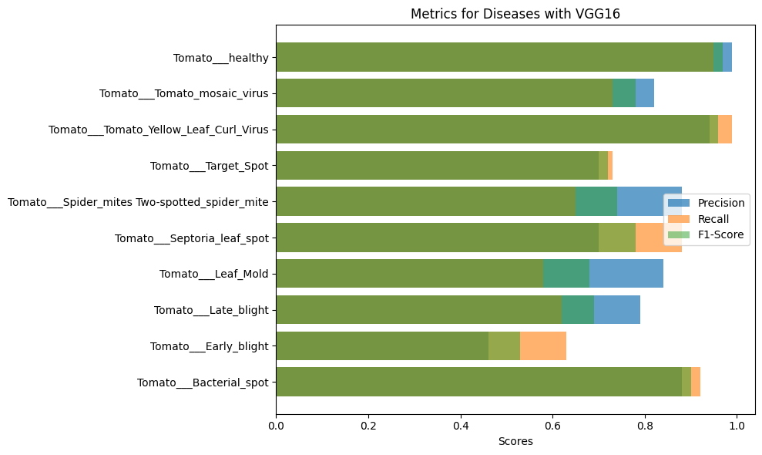
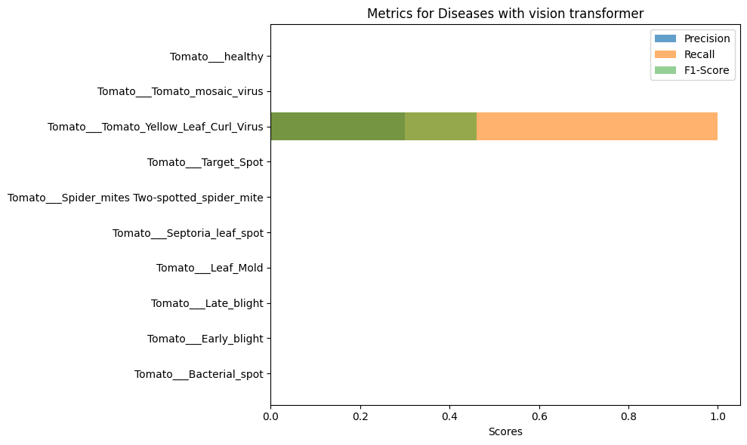
Result Analysis
VGG16
Vision transformer

Slide 17
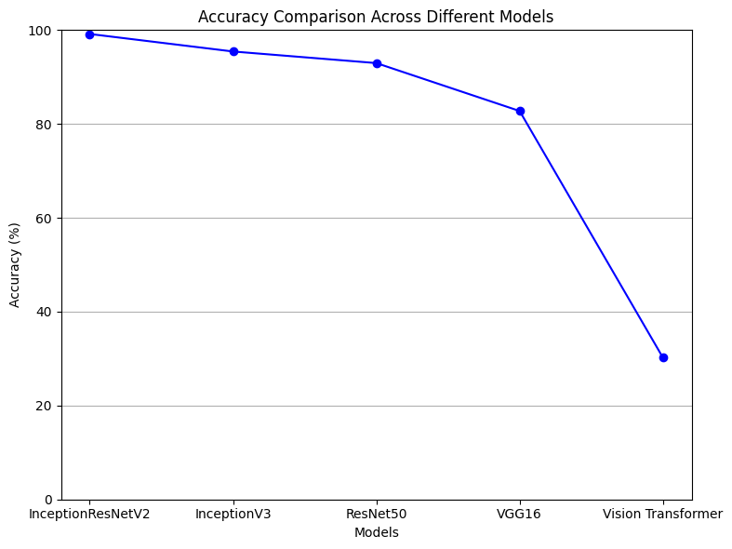
Result Analysis

Slide 18
Limitations
Requirement of the data
Computational resource
Robustness to noise inputs
Lack of Interpretability

Slide 19
Reference
[1] Thakur, P. S., Khanna, P., Sheorey, T., Ojha, A. (2022). Explainable Vision Transformer Enabled Convolutional Neural Network for Plant Disease Identification: PlantXViT. arXiv preprint arXiv:2207.07919.
[2] Borhani, Yasamin Khoramdel, Javad Najafi, Esmaeil. (2022). A deep learning based approach for automated plant disease classification using vision transformer. Scientific Reports. 12. 11554. 10.1038/s41598-022-15163-0.
[3]Anim-Ayeko, A. O., Schillaci, C., Lipani, A. (2023). Automatic blight disease detection in potato (Solanum tuberosum L.) and tomato (Solanum lycopersicum, L. 1753) plants using deep learning. Smart Agricultural Technology, 4, 100178. https://doi.org/10.1016/j.atech.2023.100178

Slide 20
Thank you for listening

